Slide 1
Visualization
ALGORITHM CLASS
ALGORITHM CLASSS
Notes:
Agorithm Class Training Institute, Hyderabad algorithm.class@gmail.com

Slide 2
PDB
import matplotlib.pyplot as plt
x=[1,2,3]
y=[5,7,4]
# 2nd graph
x2=[1,2,3]
y2=[10,14,12]
plt.plot(x,y,label='first line')
plt.plot(x2,y2,label='second line')
plt.xlabel('plot number')
plt.ylabel('var number')
plt.title('New graph\n check it out')
plt.show()
#title
Refer
https://matplotlib.org/users/pyplot_tutorial.html
ALGORITHM CLASS
Notes:
Agorithm Class Training Institute, Hyderabad algorithm.class@gmail.com

Slide 3
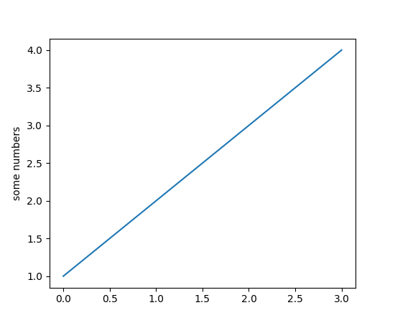
Pyplot tutorial
Pyplot tutorial
matplotlib.pyplot is a collection of command style functions that make matplotlib work like MATLAB. Each pyplot function makes some change to a figure:
e.g., creates a figure, creates a plotting area in a figure, plots some lines in a plotting area, decorates the plot with labels, etc. In matplotlib.pyplot various states are preserved across function calls, so that it keeps track of things like the current figure and plotting area, and the plotting functions are directed to the current axes (please note that “axes” here and in most places in the documentation refers to the axes part of a figure and not the strict mathematical term for more than one axis).
import matplotlib.pyplot as plt
plt.plot([1,2,3,4])
plt.ylabel('some numbers')
plt.show()
ALGORITHM CLASS
Notes:
Agorithm Class Training Institute, Hyderabad algorithm.class@gmail.com

Slide 4
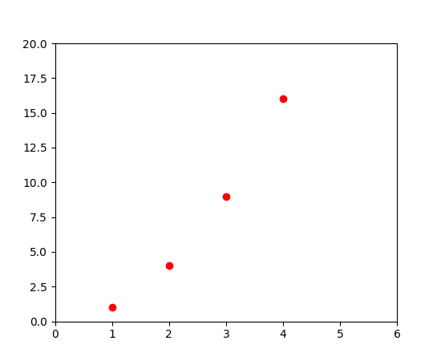
Importing the NumPy module
You may be wondering why the x-axis ranges from 0-3 and the y-axis from 1-4. If you provide a single list or array to the plot() command, matplotlib assumes it is a sequence of y values, and automatically generates the x values for you. Since python ranges start with 0, the default x vector has the same length as y but starts with 0. Hence the x data are [0,1,2,3].
plot() is a versatile command, and will take an arbitrary number of arguments. For example, to plot x versus y, you can issue the command:
plt.plot([1, 2, 3, 4], [1, 4, 9, 16])
For every x, y pair of arguments, there is an optional third argument which is the format string that indicates the color and line type of the plot. The letters and symbols of the format string are from MATLAB, and you concatenate a color string with a line style string. The default format string is ‘b-‘, which is a solid blue line. For example, to plot the above with red circles, you would issue
import matplotlib.pyplot as plt
plt.plot([1,2,3,4], [1,4,9,16], 'ro')
plt.axis([0, 6, 0, 20])
plt.show()
ALGORITHM CLASS
Notes:
Agorithm Class Training Institute, Hyderabad algorithm.class@gmail.com

Slide 5
Importing the NumPy module
This series will introduce you to graphing in python with Matplotlib, which is arguably the most popular graphing and data visualization library for Python.
Installation
Easiest way to install matplotlib is to use pip. Type following command in terminal:
pip install matplotlib
OR, you can download it from here and install it manually.
ALGORITHM CLASS
Notes:
Agorithm Class Training Institute, Hyderabad algorithm.class@gmail.com

Slide 6
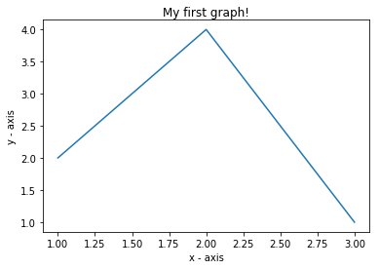
Importing the NumPy module
Getting started ( Plotting a line)
# importing the required module
import matplotlib.pyplot as plt
# x axis values
x = [1,2,3]
# corresponding y axis values
y = [2,4,1]
# plotting the points
plt.plot(x, y)
# naming the x axis
plt.xlabel('x - axis')
# naming the y axis
plt.ylabel('y - axis')
# giving a title to my graph
plt.title('My first graph!')
# function to show the plot
plt.show()
The code seems self explanatory. Following steps were followed:
Define the x-axis and corresponding y-axis values as lists.
Plot them on canvas using .plot() function.
Give a name to x-axis and y-axis using .xlabel() and .ylabel() functions.
Give a title to your plot using .title() function.
Finally, to view your plot, we use .show() function.
ALGORITHM CLASS
Notes:
Agorithm Class Training Institute, Hyderabad algorithm.class@gmail.com

Slide 7
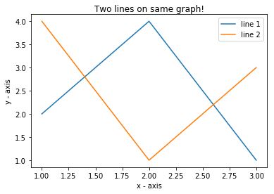
Plotting two or more lines on same plot
import matplotlib.pyplot as plt
# line 1 points
x1 = [1,2,3]
y1 = [2,4,1]
# plotting the line 1 points
plt.plot(x1, y1, label = "line 1")
# line 2 points
x2 = [1,2,3]
y2 = [4,1,3]
# plotting the line 2 points
plt.plot(x2, y2, label = "line 2")
# naming the x axis
plt.xlabel('x - axis')
# naming the y axis
plt.ylabel('y - axis')
# giving a title to my graph
plt.title('Two lines on same graph!')
# show a legend on the plot
plt.legend()
# function to show the plot
plt.show()
Here, we plot two lines on same graph. We differentiate between them by giving them a name(label) which is passed as an argument of .plot() function.
The small rectangular box giving information about type of line and its color is called legend. We can add a legend to our plot using .legend() function.
ALGORITHM CLASS
Notes:
Agorithm Class Training Institute, Hyderabad algorithm.class@gmail.com

Slide 8
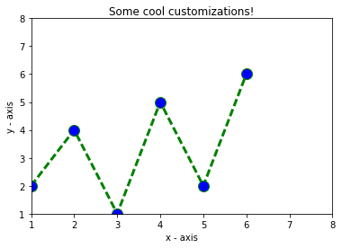
Customization of Plots
Here, we discuss some elementary customizations applicable on almost any plot.
import matplotlib.pyplot as plt
# x axis values
x = [1,2,3,4,5,6]
# corresponding y axis values
y = [2,4,1,5,2,6]
# plotting the points
plt.plot(x, y, color='green', linestyle='dashed', linewidth = 3,
marker='o', markerfacecolor='blue', markersize=12)
# setting x and y axis range
plt.ylim(1,8)
plt.xlim(1,8)
# naming the x axis
plt.xlabel('x - axis')
# naming the y axis
plt.ylabel('y - axis')
# giving a title to my graph
plt.title('Some cool customizations!')
# function to show the plot
plt.show()
As you can see, we have done several customizations like
setting the line-width, line-style, line-color.
setting the marker, marker’s face color, marker’s size.
overriding the x and y axis range. If overriding is not done, pyplot module uses auto-scale feature to set the axis range and scale.
ALGORITHM CLASS
Notes:
Agorithm Class Training Institute, Hyderabad algorithm.class@gmail.com

Slide 9
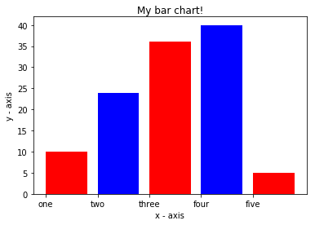
Customization of Plots
Bar Chart
import matplotlib.pyplot as plt
# x-coordinates of left sides of bars
left = [1, 2, 3, 4, 5]
# heights of bars
height = [10, 24, 36, 40, 5]
# labels for bars
tick_label = ['one', 'two', 'three', 'four', 'five']
# plotting a bar chart
plt.bar(left, height, tick_label = tick_label,
width = 0.8, color = ['red', 'blue'])
# naming the x-axis
plt.xlabel('x - axis')
# naming the y-axis
plt.ylabel('y - axis')
# plot title
plt.title('My bar chart!')
# function to show the plot
plt.show()
Here, we use plt.bar() function to plot a bar chart.
x-coordinates of left side of bars are passed along with heights of bars.
you can also give some name to x-axis coordinates by defining tick_labels
ALGORITHM CLASS
Notes:
Agorithm Class Training Institute, Hyderabad algorithm.class@gmail.com

Slide 10
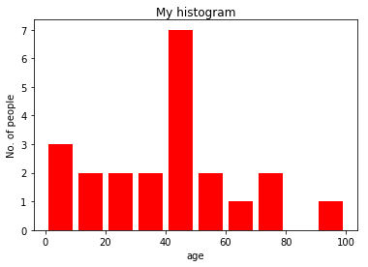
Customization of Plots
Histogram
import matplotlib.pyplot as plt
# frequencies
ages = [2,5,70,40,30,45,50,45,43,40,44,
60,7,13,57,18,90,77,32,21,20,40]
# setting the ranges and no. of intervals
range = (0, 100)
bins = 10
# plotting a histogram
plt.hist(ages, bins, range, color = 'red',
histtype = 'bar', rwidth = 0.8)
# x-axis label
plt.xlabel('age')
# frequency label
plt.ylabel('No. of people')
# plot title
plt.title('My histogram')
# function to show the plot
plt.show()
Here, we use plt.hist() function to plot a histogram.
frequencies are passed as the ages list.
Range could be set by defining a tuple containing min and max value.
Next step is to “bin” the range of values—that is, divide the entire range of values into a series of intervals—and then count how many values fall into each interval. Here we have defined bins = 10. So, there are a total of 100/10 = 10 intervals.
ALGORITHM CLASS
Notes:
Agorithm Class Training Institute, Hyderabad algorithm.class@gmail.com

Slide 11
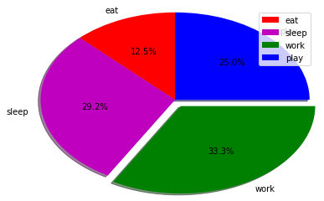
Customization of Plots
Pie-chart
import matplotlib.pyplot as plt
# defining labels
activities = ['eat', 'sleep', 'work', 'play']
# portion covered by each label
slices = [3, 7, 8, 6]
# color for each label
colors = ['r', 'm', 'g', 'b']
# plotting the pie chart
plt.pie(slices, labels = activities, colors=colors,
startangle=90, shadow = True, explode = (0, 0, 0.1, 0),
radius = 1.2, autopct = '%1.1f%%')
# plotting legend
plt.legend()
# showing the plot
plt.show()
Here, we plot a pie chart by using plt.pie() method.
First of all, we define the labels using a list called activities.
Then, portion of each label can be defined using another list called slices.
Color for each label is defined using a list called colors.
shadow = True will show a shadow beneath each label in pie-chart.
startangle rotates the start of the pie chart by given degrees counterclockwise from the x-axis.
explode is used to set the fraction of radius with which we offset each wedge.
autopct is used to format the value of each label. Here, we have set it to show the percentage value only upto 1 decimal place.
ALGORITHM CLASS
Notes:
Agorithm Class Training Institute, Hyderabad algorithm.class@gmail.com

Slide 12
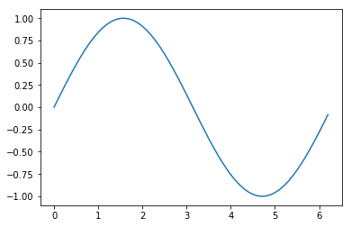
Customization of Plots
Plotting curves of given equation
# importing the required modules
import matplotlib.pyplot as plt
import numpy as np
# setting the x - coordinates
x = np.arange(0, 2*(np.pi), 0.1)
# setting the corresponding y - coordinates
y = np.sin(x)
# potting the points
plt.plot(x, y)
# function to show the plot
plt.show()
Here, we use NumPy which is a general-purpose array-processing package in python.
To set the x – axis values, we use np.arange() method in which first two arguments are for range and third one for step-wise increment. The result is a numpy array.
To get corresponding y-axis values, we simply use predefined np.sin() method on the numpy array.
Finally, we plot the points by passing x and y arrays to the plt.plot() function.
So, in this part, we discussed various types of plots we can create in matplotlib. There are more plots which haven’t been covered but the most significant ones are discussed here –
ALGORITHM CLASS
Notes:
Agorithm Class Training Institute, Hyderabad algorithm.class@gmail.com

